Slide 1
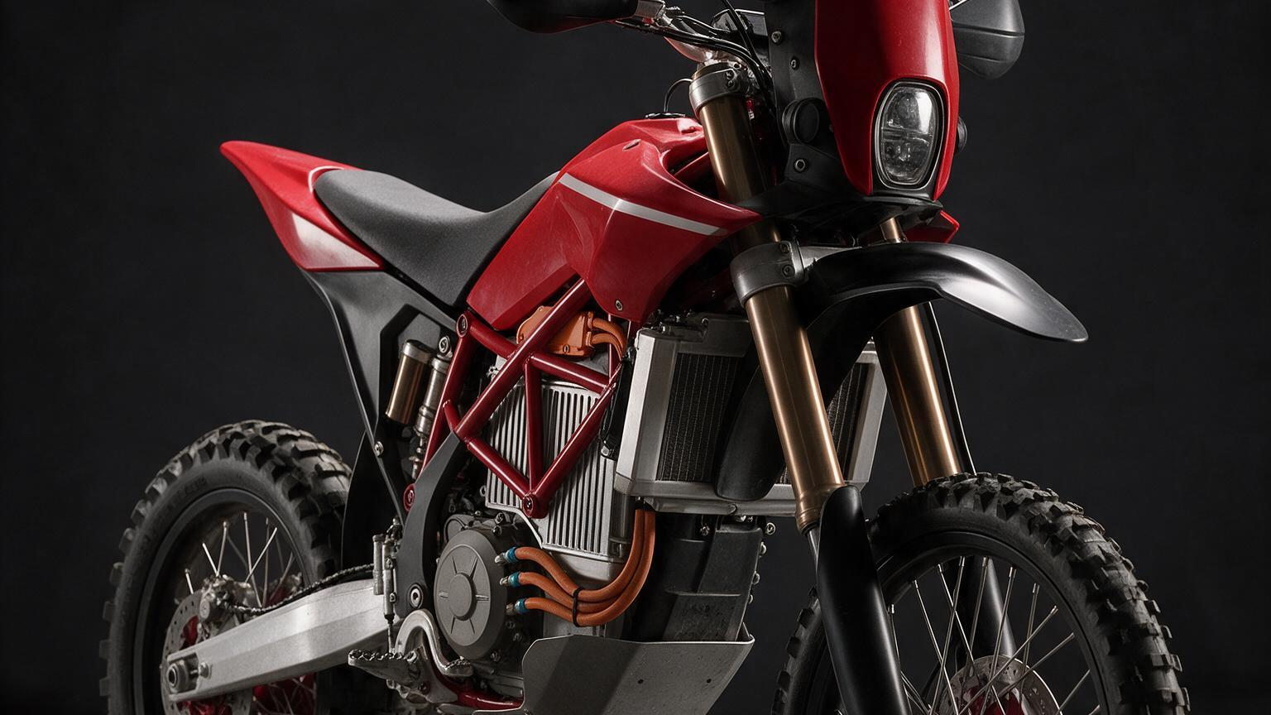
THE BAJA DUCATI
A machine that reads Ducati and survives the desert.

Slide 2
“Ducati is road-race DNA — rigid trellis, low stance, mass tucked tight. Baja is the physical opposite. The marvel is a machine that reads Ducati and survives the desert.”
THE ENGINEERING TENSION, AND THE PITCH
THE BAJA DUCATI · CONFIDENTIAL · SEED

Slide 3
THE PROBLEM
Two machines in opposition
What reads Ducati
What survives Baja
Rigid steel trellis, mass central and forward
Low stance, short travel, tight tuck
Sealed for tarmac, not for dust
300 mm of wheel travel, a tall stance
A long wheelbase for stability over whoops
Everything sealed against abrasive sand
THE BAJA DUCATI · CONFIDENTIAL · SEED

Slide 4
THE RESOLUTION
Not a compromise — a deliberate re-mapping
Keep the Ducati cues that are visual and architectural: the trellis language, the tank-to-tail line, mass visually centralized, the naked-mechanical aesthetic.
Discard the cues that are dynamic: the low stance, the short travel, the sealed-for-tarmac philosophy.
Series-hybrid is what makes this resolvable, not merely stylable: the engine never touches the driveline, so mass is placed by the physics of handling — not by a chain run.
Ducati language on rally-raid proportions. A tall, long, wide-footed desert machine wearing a trellis.
THE BAJA DUCATI · CONFIDENTIAL · SEED

Slide 5
WHY NOW
Two advantages no throttle cable can match
200 mi
ms
1 point
RANGE WITH NO CHARGER — FUEL CARRIES THE ENERGY, THE BATTERY CARRIES THE DYNAMICS
E-MOTOR TORQUE METERED AT MILLISECOND RESOLUTION — THE SAND ADVANTAGE
THE GENSET RUNS AT ITS SINGLE BEST-EFFICIENCY POINT, DECOUPLED FROM ROAD SPEED
The 'why now' lives in the powertrain: desert range without charging infrastructure, plus e-motor torque control that meters slip in soft sand faster and finer than any throttle cable — where the line between drive and dig-in is a few percent of wheelspin.
THE BAJA DUCATI · CONFIDENTIAL · SEED

Slide 6
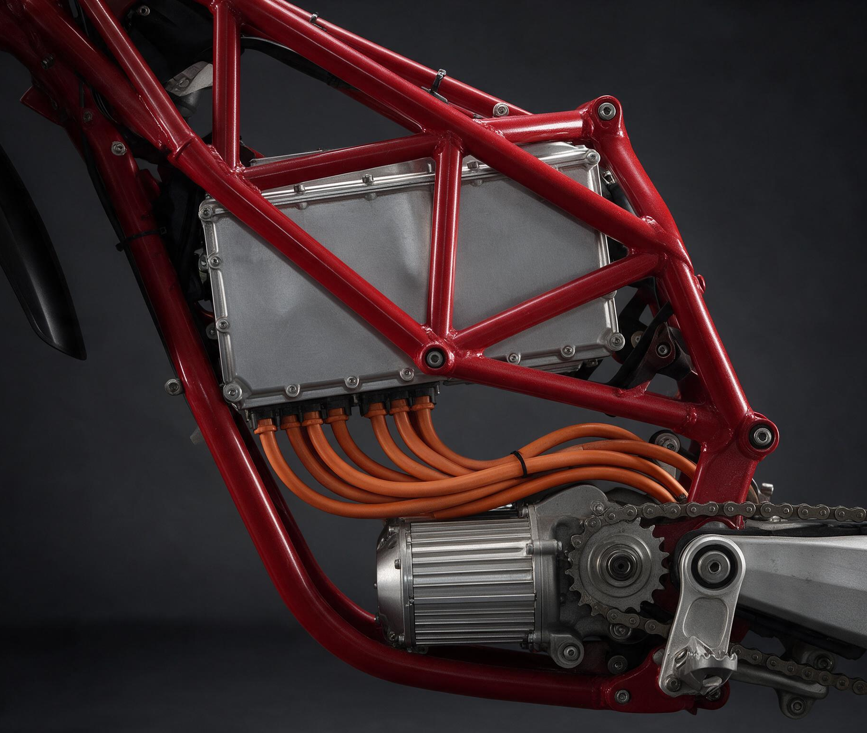
THE ARCHITECTURE
The wheels are only ever driven by the electric motor
A series hybrid (range-extended EV). The engine has no mechanical path to the ground — it spins a generator at its efficient RPM to feed the DC bus and top up the battery.
Battery, central in the frame triangle — the densest mass, where a Ducati's engine sits
Axial-flux motor at the swingarm pivot — 94 mm long, minimal overhang
Small range-extender genset, tucked low and rear
Ride-by-wire: the throttle is a torque request, not a butterfly
THE BAJA DUCATI · CONFIDENTIAL · SEED

Slide 7
GROUNDED, NOT GUESSED
Every block is a real part — or a proven part-class
The frame is bespoke too. The risk is not in inventing components — it is in the three bespoke subsystems (frame, pack, genset), and those are named as hard.
Subsystem | Named supplier | Sourcing
Traction motor | EMRAX 228 / 268 axial-flux | COTS
Inverter | Cascadia Motion, HEV-rated | COTS
Battery cells | Molicel P42A / P45B | COTS
Suspension | WP rally, ~300 mm travel | COTS
Battery pack | Bespoke — sealed, liquid-cooled | Bespoke
Range-extender genset | Bespoke — ICE + PM generator | Bespoke
THE BAJA DUCATI · CONFIDENTIAL · SEED

Slide 8
THE HARD PARTS, NAMED AS HARD
Here is the risk, and here is the mitigation
Hybrid packaging vs. Ducati mass centralization — the defining design task. Solvable because series-hybrid decouples the ICE, but real work.
Range-extender genset — no off-the-shelf motorcycle-scale unit exists. An integration job: engine + PM generator + controller. The longest pole.
Weight lands ~200–240 kg wet — heavier than a pure rally bike. We own the number; an insider who does the mass math will distrust a claimed 170 kg.
Sand ingress + desert thermal — known fixes (IP66/67, dual cooling loops), unforgiving of any single miss.
Desert traction-control calibration — development, not invention. The e-motor's fine torque control is what makes a good desert calibration possible.
THE BAJA DUCATI · CONFIDENTIAL · SEED

Slide 9
Buildable. The risk is execution, not physics.

Slide 10
THE MARKET
Where a Ducati-register desert machine sits
Premium
Strategic
First-of-kind
A HALO MACHINE IN THE REGISTER OF KTM RALLY, DUCATI DESERTX, THE ELECTRIC-ADVENTURE FRONTIER
BUILT TO BE PRESSURE-TESTED BY A MANUFACTURER OR RACE OUTFIT — CREDIBILITY IS THE PRODUCT
A SERIES-HYBRID DESERT MOTORCYCLE PROVING DESERT RANGE WITHOUT CHARGING INFRASTRUCTURE
This is a strategic, insider-facing machine: the audience is a manufacturer, a race outfit, or moto money who know bikes cold. The value is a defensible, first-of-kind architecture — the prototype is what makes the market conversation real.
THE BAJA DUCATI · CONFIDENTIAL · SEED

Slide 11
PROTOTYPE PLAN
One running, desert-tested machine — NRE-dominated
The parts total ~€51k–€105k; the engineering that makes them a first-of-kind machine totals ~€290k–€690k — five to six times the hardware. The three cost drivers are the three hard parts: genset integration (€60–140k), battery-pack engineering (€50–120k), frame engineering (€40–90k). Planning centre: ~€500k–€600k.
Bucket | Low | High
Components (hardware on the machine) | ~€51k | ~€105k
NRE, integration & test | ~€290k | ~€690k
Total prototype | ~€341k | ~€795k
THE BAJA DUCATI · CONFIDENTIAL · SEED

Slide 12
THE TIMELINE
Built backward from the genset pole
~14–20
3
co-design
MONTHS, ARCHITECTURE LOCK TO A DESERT-TESTED RUNNING PROTOTYPE
LONG POLES: GENSET (~20–36 WK), FRAME (~12–24 WK), BATTERY PACK (~16–28 WK)
THE THREE INTERLOCK — THE FRAME IS BUILT AROUND THE PACK AND GENSET ENVELOPES
Done when the machine has completed a real desert test day — not when it first turns a wheel. Contract more of the genset and pack work and it lands nearer 14 months; a leaner in-house build lands nearer 20.
THE BAJA DUCATI · CONFIDENTIAL · SEED

Slide 13
THE ASK
A first round to reach the machine that proves the thesis
€1.0–1.8M
€500–600k
1 machine
FIRST-ROUND ENVELOPE: THE PROTOTYPE PLUS ~12–20 MONTHS OF A LEAN SENIOR TEAM, WORKSHOP AND TEST PROGRAM
THE PROTOTYPE ITSELF, NRE-DOMINATED — THE PLANNING CENTRE TO BUILD AGAINST
WHAT THE RAISE FUNDS WELL: ONE DEMONSTRABLE, DESERT-TESTED PROTOTYPE
This raise does not claim to fund homologation, volume tooling, or a production line — and saying so is the credibility move. It funds the prototype that makes those the next conversation. The money is spent on integration and engineering execution, not on unproven physics: a fundable risk profile.
THE BAJA DUCATI · CONFIDENTIAL · SEED

Slide 14
A machine you can watch cross the desert.
Ducati language on rally-raid proportions.
Series-hybrid. Electric-primary. Ride-by-wire.
The risk is execution — and that is the fundable kind.
Every load-bearing number in this deck traces to the feasibility dossier and its grounded sources, or is an honest range with its basis named.

