Slide 1
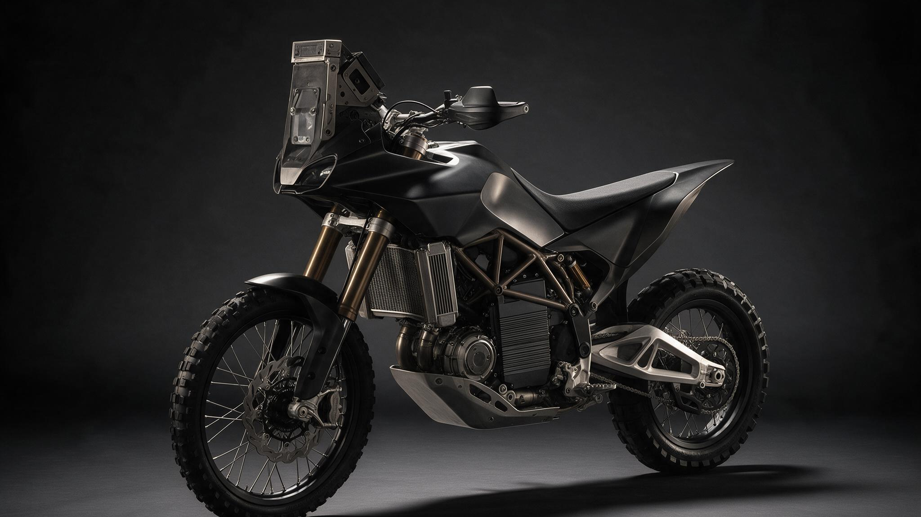
DUNA
A desert race machine, re-engineered as software · A Baja / Dakar-class rally-raid race motorcycle · series-hybrid powertrain · full by-wire control · Confidential 2026

Slide 2
01
The most advanced desert race machine on earth — and a new powertrain proven doing it

Slide 3
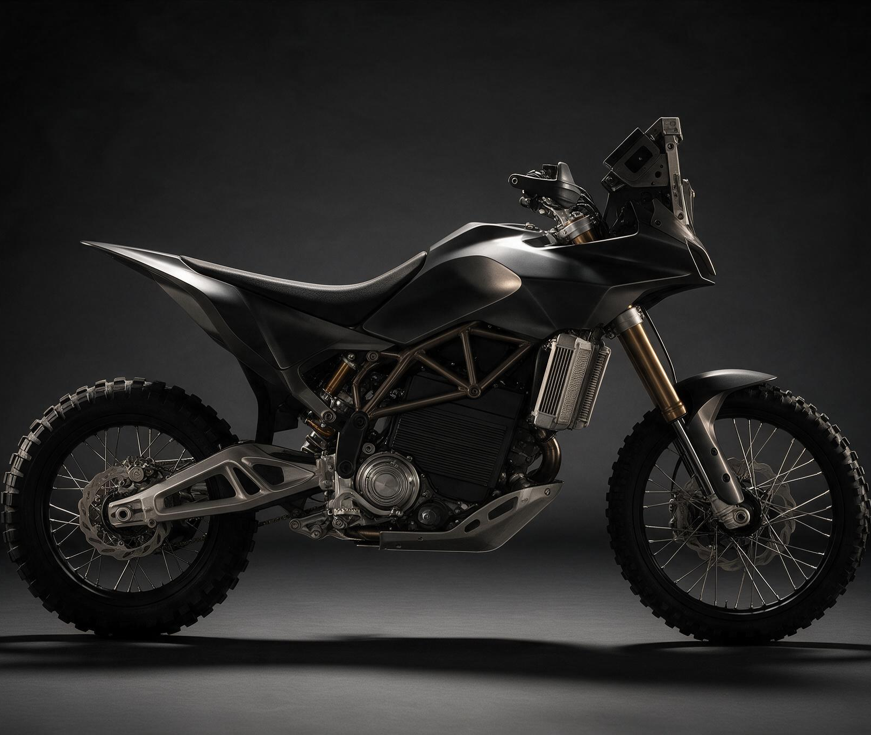
THE THESIS
Rally-raid has never had a software-defined powertrain
A small engine runs at one fixed, most-efficient point as a generator only — no mechanical link to the wheel. It feeds a buffer battery and an electric motor that drives the rear wheel. The rider commands wheel torque; software commands everything else.
Instant, exact torque — slip control that clamps in a millisecond, not by fighting an engine
Range is a fuel-tank question, not a charging problem — refuels in the time it takes to pour fuel
Silent low-speed running on the buffer — a tactical stealth capability
Every component exists and is proven elsewhere. The innovation is integration, not invention.
CONFIDENTIAL · 2026 · SERIES-HYBRID RALLY-RAID PROGRAM

Slide 4
THE PERFORMANCE BAR WE RESPECT
Measured against the best 450 rally bikes on earth
139 kg
~47 kW
35 L
KTM 450 RALLY DRY WEIGHT — THE BAR (VERIFIED, KTM.COM)
KTM PEAK POWER — OUR ELECTRIC DRIVE EXCEEDS IT (86 KW PEAK MOTOR)
REFERENCE FUEL CAPACITY — RANGE = TANK SIZE
KTM 450 Rally Replica and Honda CRF450 Rally are the raceability reference — ~140 kg class, ~35 L fuel, hours at load in the heat, serviceable in a bivouac. Our answer is heavier by a known, quantified margin and defensible on handling, efficiency, and control.
CONFIDENTIAL · 2026 · SERIES-HYBRID RALLY-RAID PROGRAM

Slide 5
02
A category never re-invented, and a proving ground you can enter with one prototype

Slide 6
WHY NOW
The software-defined powertrain moment has arrived
The parts are finally real
The door is open
Axial-flux traction motors at 10 kg, 86 kW peak (EMRAX 208, VERIFIED)
Motorsport inverters at 6.75 kg, IP6K9K wash-rated (Cascadia CM200, VERIFIED)
High-rate 21700 cells at 231 Wh/kg (Molicel P45B, VERIFIED)
Compact rotary range-extenders that love one fixed RPM (Aixro XR50, VERIFIED)
US desert racing (Baja 1000 / SCORE) — fewer rules constraints, a prototype can enter sooner: the near-term proving ground
Dakar Future / Mission 1000 — ASO's official hybrid & alternative-propulsion on-ramp (VERIFIED)
FIM already runs Equivalence-of-Technologies rules for electric vs ICE
Dakar is the aspirational ceiling. SCORE/Baja is where we prove it first.
CONFIDENTIAL · 2026 · SERIES-HYBRID RALLY-RAID PROGRAM

Slide 7
“Series hybrid turns every hard mechanical problem — traction, torque delivery, engine efficiency, thermal — into a software problem. It is a software-defined powertrain in a category that has never had one.”
THE INVESTABLE THESIS, IN ONE LINE
CONFIDENTIAL · 2026 · SERIES-HYBRID RALLY-RAID PROGRAM

Slide 8
03
Ducati-grade design language over genuine desert race engineering

Slide 9
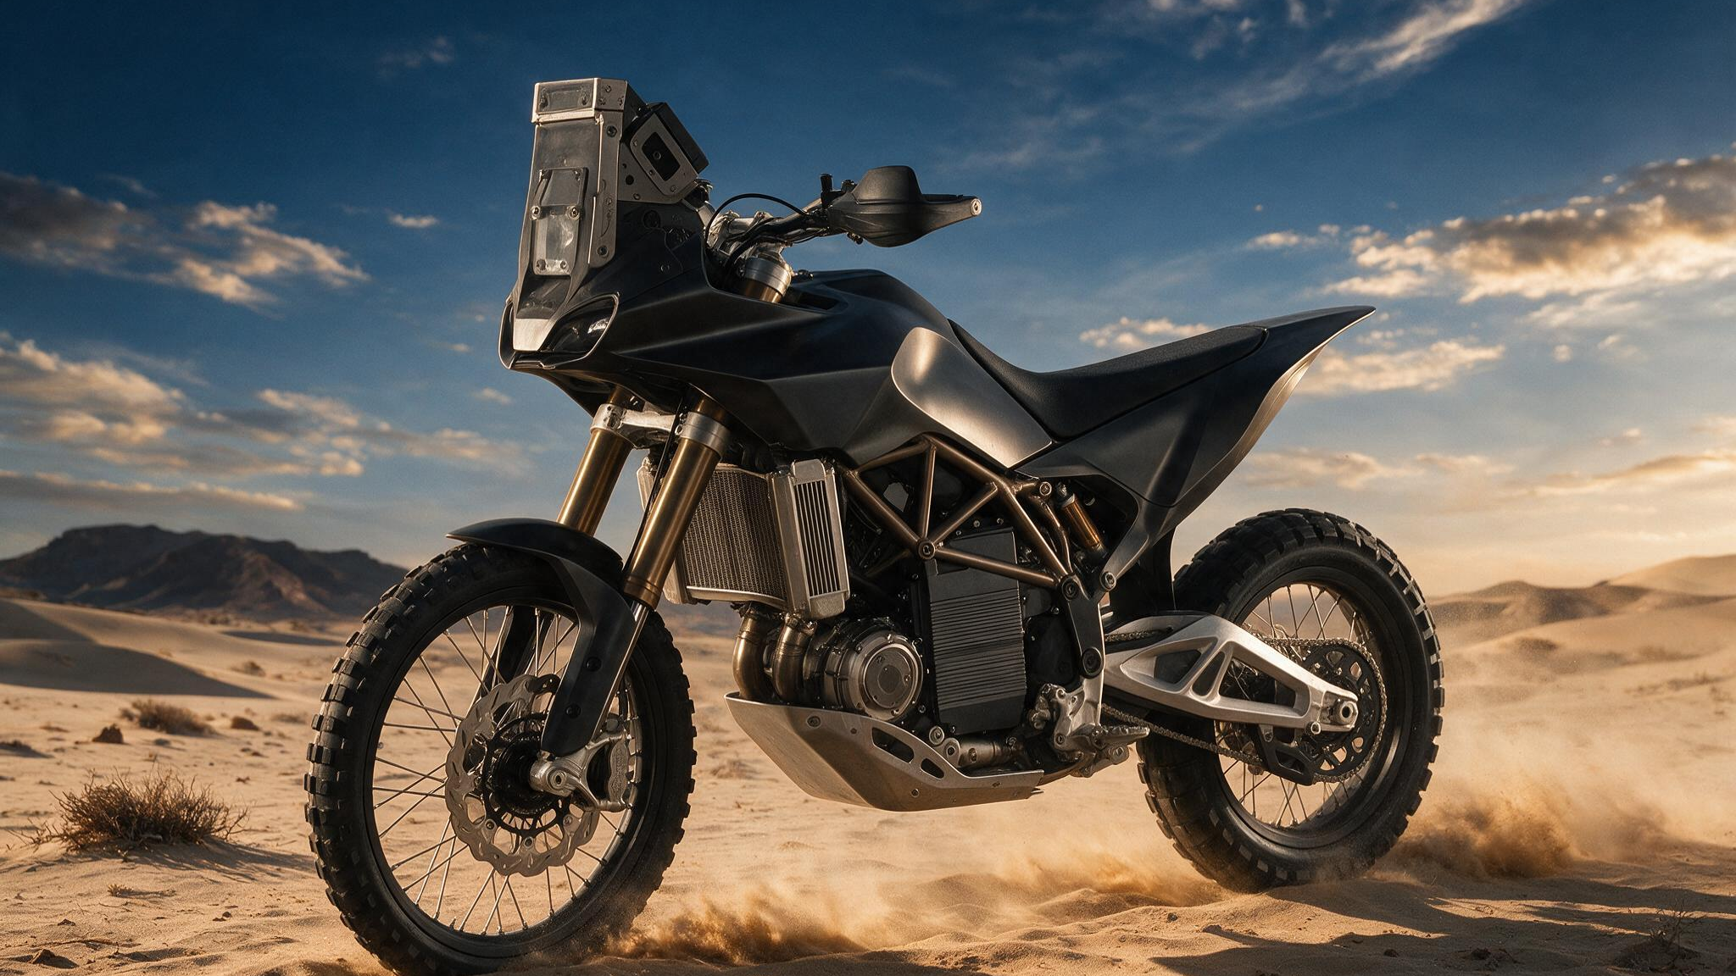
Exposed Core, stealth graphite
The canonical form — battery low and central, no gearbox bulge, no top-end engine · Baja terrain

Slide 10
THE ENERGY PATH
No gearbox, no mechanical link to the wheel
What the engine does
What the battery does
The APU runs at one fixed, efficient point and delivers a smooth ~12–15 kW. It never chases transients — it just holds its best-efficiency point. This is why a series hybrid is efficient in a spiky, stop-start duty cycle like rally.
A ~2.0 kWh buffer absorbs generator surplus and supplies bursts up to ~31 kW for dune climbs and launches. It is a shock absorber between a steady genset and a spiky wheel demand — a buffer, not an EV pack.
CONFIDENTIAL · 2026 · SERIES-HYBRID RALLY-RAID PROGRAM

Slide 11
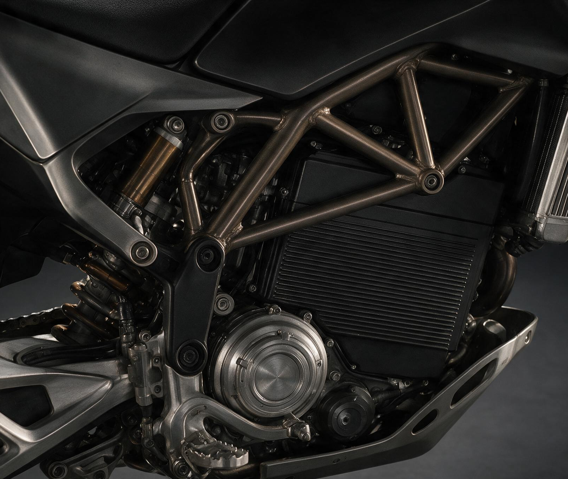
THE CORE
The whole trick lives on one DC bus
Buffer pack in the frame, axial-flux motor, twin radiators. A single fixed reduction replaces the KTM's six-speed gearbox — an electric motor's flat torque curve removes the need for gears.
EMRAX 208 traction motor — 86 kW peak / 56 kW continuous, 10 kg
Cascadia CM200 inverter — 225 kW rated, 6.75 kg, wash-proof
96s2p Molicel P45B buffer — ~2.0 kWh usable, low and central
Aixro XR50 rotary as the generator — buyable today
CONFIDENTIAL · 2026 · SERIES-HYBRID RALLY-RAID PROGRAM

Slide 12
04
Once torque is a software variable, control is nearly free — and it compounds

Slide 13
THE DEFENSIBLE STACK
Mechanical problems become software problems
Traction-by-wire
The compounding advantage
The VCU knows commanded torque, both wheel speeds, and lean angle in real time. Slip control clamps motor torque the instant the rear outruns a target slip ratio — roughly 100× faster than fighting an engine with ignition or a butterfly. Lean-sensitive torque and per-surface launch maps are trivial once torque is a software variable.
The engine's thermal load is decoupled from vehicle speed — the VCU can crawl on battery to shed heat, then restart
Torque maps per surface: sand, gravel, hardpack, rider-selectable
Two-motor torque vectoring (true AWD in sand) is a clean roadmap option
Every kilometre ridden makes the maps better — the software is the asset
CONFIDENTIAL · 2026 · SERIES-HYBRID RALLY-RAID PROGRAM

Slide 14
BY-WIRE CONTROL — PROTOTYPE-HONEST
What is mature, and what is the real work
Throttle-by-wire: dual-redundant grip sensors. Shipped on every premium bike today. Low risk.
Brake: prototype runs a conventional hydraulic front (fail-safe) blended with by-wire regen on the rear — the responsible choice for a solo high-speed machine. Full dry brake-by-wire is the named production path, not the prototype spec.
VCU: the brain — torque map, slip control, generator set-point, thermal management, regen blending. This is the single biggest build-cost line, and we treat it as such.
Safety-conscious architecture designed toward functional safety — HV interlock, pyro-fuse crash disconnect, redundant channels, watchdog. We do not claim certification on a prototype.
CONFIDENTIAL · 2026 · SERIES-HYBRID RALLY-RAID PROGRAM

Slide 15
05
The honest numbers — because the answers survive a mechanical engineer in the room

Slide 16
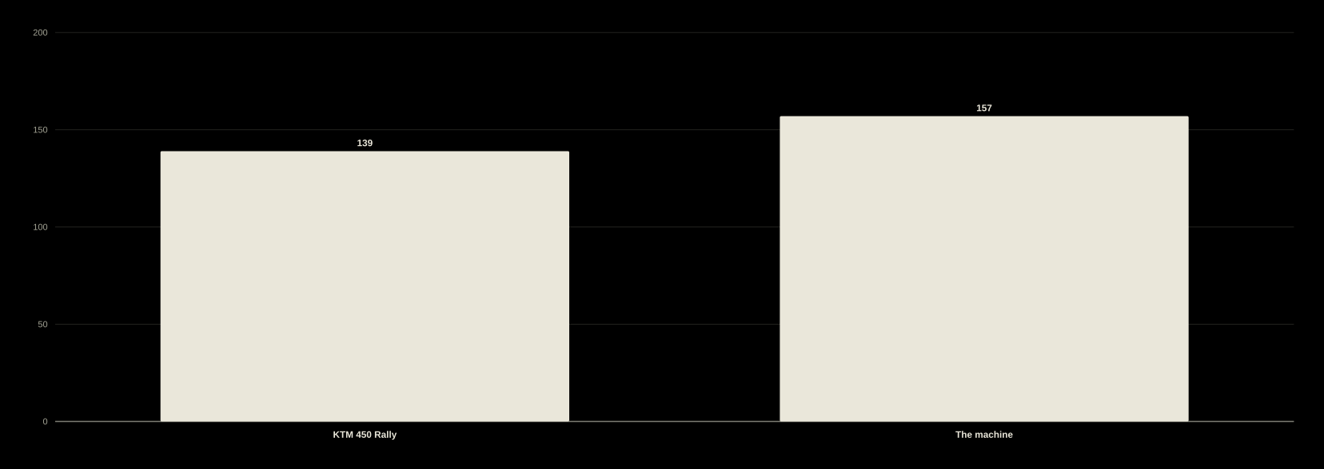
THE HONEST WEIGHT VERDICT
~+18 kg dry (~+13% vs KTM) — quantified, not hidden
Sum of verified component masses + estimated structure. The penalty is powertrain duplication (both an APU and a full e-drive); the offset is that the heaviest item sits low and central, lowering CG.
CONFIDENTIAL · 2026 · SERIES-HYBRID RALLY-RAID PROGRAM

Slide 17

THE STRUCTURAL ADVANTAGE
Range scales with the tank, not the battery
Want 500 km instead of 400? Add ~12 L (~9 kg) of fuel — not ~40 kWh of battery (~180 kg). This is the series-hybrid advantage, and it is real. Figures are engineering estimates from the master numbers (20 kW stage average, ~27% fuel-to-wheel).
CONFIDENTIAL · 2026 · SERIES-HYBRID RALLY-RAID PROGRAM

Slide 18
NO PHYSICS WALL
Every component is real, spec'd, and proven elsewhere
157 kg
~27%
~40 L
DRY MASS — RE-ADDED FROM VERIFIED COMPONENTS (EST)
FUEL-TO-WHEEL EFFICIENCY — THE MATH SHOWN, NOT OVER-CLAIMED (EST)
DESIGN TANK FOR A ~340 KM SPECIAL — SCALES LINEARLY
The risk is integration, not invention. The three risks that actually decide this program are weight, controls software, and the stage-power assumption — each named, quantified, and with a concrete retirement plan on the timeline.
CONFIDENTIAL · 2026 · SERIES-HYBRID RALLY-RAID PROGRAM

Slide 19
06
The honest risk section is the credibility — nothing here is hand-waved

Slide 20
THE THREE RISKS THAT DECIDE THE PROGRAM
Named, quantified, each with a retirement plan
We own the 20 kW assumption first, as a Phase-0 validation plan — not as an ambush. All range/fuel/APU math scales off it, and it is the one number diligence will push on.
Risk | Severity × likelihood | How it retires
Weight (+~13% vs KTM) | High × certain | Package all major mass low & central; model in multibody sim, then prove on a rider. Beat the KTM on handling, not the scale.
Controls software maturity | High × high | Develop maps on a dyno + HIL rig before open-desert running. The biggest cost line, treated as such.
The 20 kW stage-average assumption | High × medium | Phase-0 telemetry: data-log a real 450 at Baja pace before freezing APU & tank. Closeable in ~2 weeks.
CONFIDENTIAL · 2026 · SERIES-HYBRID RALLY-RAID PROGRAM

Slide 21
07
Prove the hardest subsystem in the cheapest, safest place first

Slide 22
~18–24 MONTHS TO A RUNNING, SHAKEN-DOWN PROTOTYPE
Risk retires in the right order
Phase 0–1 — freeze & bench
Phase 2–3 — roll & shake down
Phase 0 (Mo 0–3): close the power assumption with telemetry, freeze BOM & voltage architecture, order long-lead items
Phase 1 (Mo 3–9): the powertrain runs on a bench — APU genset, buffer pack, motor + inverter on a dyno, VCU on HIL
Retires the fuel math and the bulk of the controls risk before anything moves
Phase 2 (Mo 6–15): CAD, CG/handling sim, fabricate chassis, first rolling self-powered running
Phase 3 (Mo 15–24): dust + shaker durability, progressive desert testing, HV crash-safety, map refinement
Deliverable: a prototype that completes a representative stage — the data package for Mission 1000 and the next raise
Critical path: the APU generator integration and the controls software
CONFIDENTIAL · 2026 · SERIES-HYBRID RALLY-RAID PROGRAM

Slide 23
08
This raise buys a running proof-of-concept. The race program is the next raise.

Slide 24
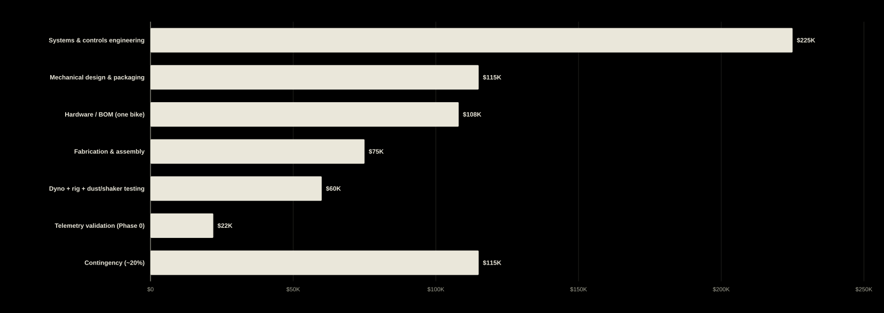
USE OF FUNDS — ONE RUNNING PROTOTYPE
~$0.75M buys one running proof-of-concept bike
Budgetary estimate for ONE proof-of-concept bike. Does NOT include a race season, a spare bike, a team, or homologation testing — those are the next raise. A prototype is dominated by engineering labor, not parts.
CONFIDENTIAL · 2026 · SERIES-HYBRID RALLY-RAID PROGRAM

Slide 25
PHASED CAPITAL, STATED HONESTLY
A seed-stage number that proves the thesis
~$0.75M
18–24 mo
Phase 2
THIS RAISE — ONE RUNNING PROOF-OF-CONCEPT PROTOTYPE
TO A SHAKEN-DOWN BIKE THAT COMPLETES A REPRESENTATIVE STAGE
THE RACE PROGRAM — THE NEXT, LARGER, DE-RISKED RAISE
A factory Dakar bike program runs into the tens of millions per season. A single innovative prototype at ~$0.75M is credible and modest against that — exactly what a venture investor funds to de-risk the next, larger raise.
CONFIDENTIAL · 2026 · SERIES-HYBRID RALLY-RAID PROGRAM

Slide 26
DUNA
The proving ground is open. The parts are real. The moat is the software.
A Baja / Dakar-class rally-raid race machine with the first software-defined powertrain in its category.
This raise builds the running proof-of-concept. The race program follows, de-risked.
Every load-bearing number traces to the feasibility dossier and its verified sources.
Confidential · 2026 · Numbers travel together with the feasibility dossier

